Slide 1
Team Members :
Royal rulers
Team Name :
Overview :
Introduction of Ambient Intelligence
History of Ambient Intelligence.
Elements of Ami
Application of ami
Advantages of Ami
Disadvantages of ami
Future of ami
Conclusion
Sarthak Khatiwada
Saugat Sapkota
Rosa Lamichhane .

Slide 2
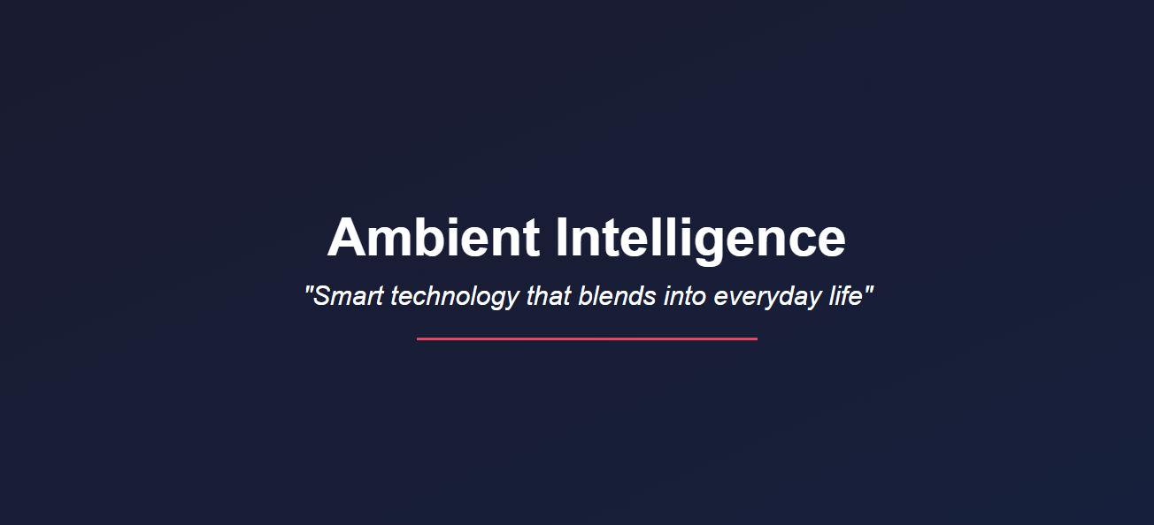

Slide 3
Introduction of Ambient Intelligence
Ambient intelligence is the concept of capturing and processing data through sensors, processors, and actuators unobtrusively embedded throughout the environment. Leveraging artificial intelligence (AI), ambient systems provide connected, seamless, uninterrupted everyday experiences that require no human intervention. These ubiquitous devices use ambient compute to respond to and adapt to the presence of people.
☆ Examples of ambient technology :
Voice assistants: Use speech recognition to perform tasks
Wearable technology: Monitors vital signs, activity, and sleep
Smart mirrors: Recommend items based on user preferences
Vehicles: Sense location, traffic, and conditions to optimize routes
Smart homes: Use environmental controls to optimize lighting, acoustics, and equipment

Slide 4
History of Ambient Intelligence
• In 1998 Philips and Palo Alto Ventures coined the term 'Ambient Intelligence' (Aml)
In 1999, Philips joined the Oxygen alliance.
international consortium of industrial partners within the context of the MIT Oxygen project, aimed at developing technology for the computer of the 21st century.
• In 2001, the concept of Ambient Intelligence (AmI) was taken up by European Commission's Information Society Technologies Advisory Group (ISTAG).

Slide 5
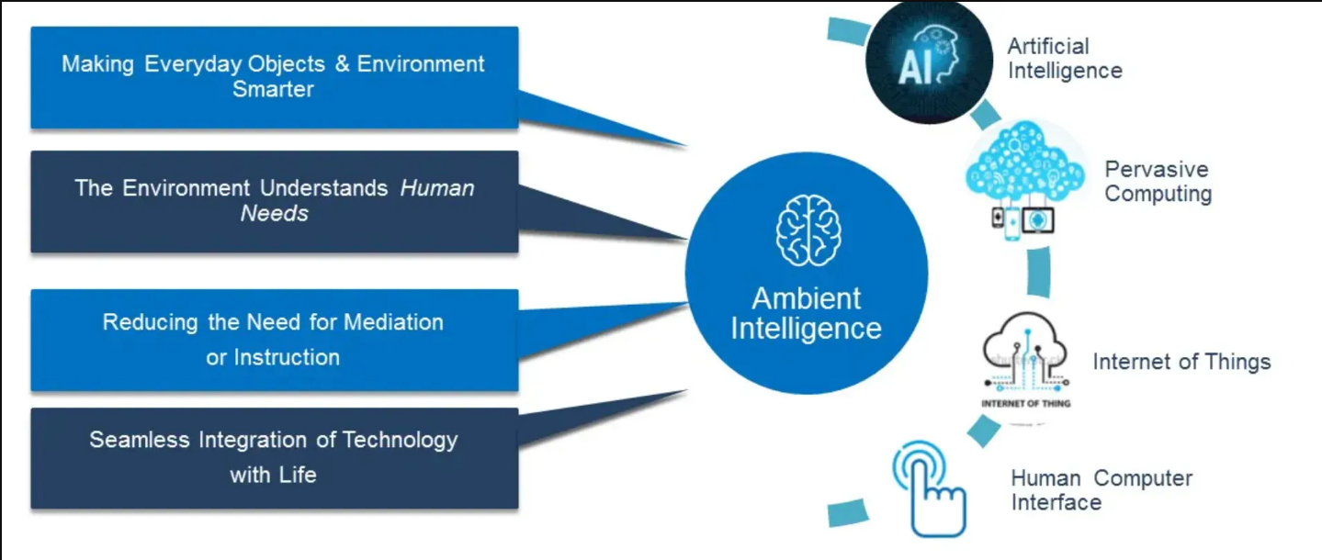
Elements of Ambient Intelligence

Slide 6
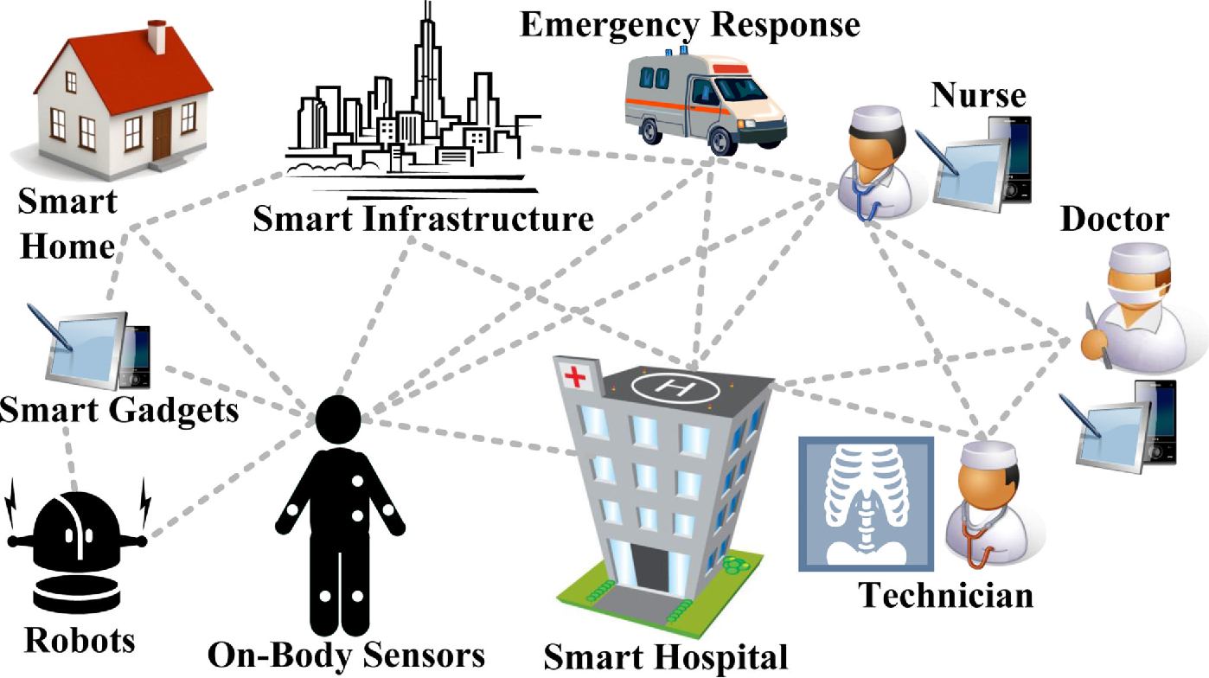
Applications of Ambient Intelligence
Smart homes
Healthcare
Transportation
Education

Slide 7
How Ambient Intelligence works ?
1)Sensing – Smart sensors collect real-time data about the environment and user behavior.
2. Processing & AI Analysis – AI and Machine Learning analyze this data to understand user needs.
3. Context Awareness – The system adapts its behavior based on the situation.
4. Automation & Response – Devices automatically adjust settings to enhance user experience.

Slide 8
Advantages of Ambient Intelligence:
1.Enhanced User Experience
2. Automation and Convenience
3. Energy Efficiency
4. Improved Health Monitoring
5. Increased Safety and Security
6. Seamless Connectivity

Slide 9
Disadvantages of Ambient Intelligence:
Privacy Concerns
High Implementation Costs
Dependency on Technology
Security Vulnerabilities
Ethical Issues
Complexity and Maintenance

Slide 10
Future of Ambient Intelligence
what if the technology around you could predicts your need before you even had to ask ?
Growth in smart cities with intelligent infrastructure.
Expansion of personalized healthcare and remote monitoring.
Enhanced home automation for energy efficiency and convenience.
Increasing focus on privacy and ethical AI development.
Seamless integration of IoT, AI, and big data for smarter ecosystems.

Slide 11
Conclusion
Ambient Intelligence (AmI) enhances everyday life by creating smart, adaptive, and user-focused environments. While it offers convenience and efficiency, challenges like privacy and security must be addressed. With responsible implementation, AmI can revolutionize how we interact with technology.

Slide 12
THANK YOU

